Slide 2
Memory Networks for Language Understanding
Antoine Bordes - Facebook AI Research
LXMLS – Lisbon July 28, 2016

Slide 3
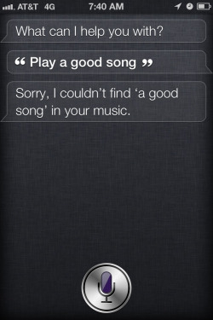
Bots?

Slide 4
End-to-End Dialog Agents
We believe a true dialog agent should:
Be able to combine all its knowledge and reason to fulfill complex tasks
Handle long open-ended conversations involving effectively tracking and predicting dialog and world states
Be able to learn (new tasks) and acquire knowledge via conversation and reading (and observing the world in multimodal scenarios).
Our directions:
Machine Learning End-to-End systems.
Creation (and release) of datasets for training/evaluating those.

Slide 5
Memory Networks (Weston et al., ICLR15; Sukhbaatar et al., NIPS15)
Class of models that combine large memory with learning component that can read and write to it.
Incorporates reasoning with attention over memory (RAM).
Most ML has limited memory which is more-or-less all that’s needed for “low level” tasks e.g. object detection.
Our motivation: long-term memory is required to read a story and then e.g. answer questions about it.
Similarly, it’s also required for dialog: to remember previous dialog (short- and long-term), and respond.

Slide 6
bAbI Tasks (Weston et al., ICLR16)
Set of 20 tasks testing basic reasoning capabilities for QA from stories
Short stories are generated from a simulation
Easy to interpret results / test a broad range of properties
Useful to foster innovation: cited ~100 times
John dropped the milk.
John took the milk there.
Sandra went to the bathroom.
John moved to the hallway.
Mary went to the bedroom.
Where is the milk ? Hallway
The suitcase is bigger than the chest.
The box is bigger than the chocolate.
The chest is bigger than the chocolate.
The chest fits inside the container.
The chest fits inside the box.
Does the suitcase fit in the chocolate? no
Task 3: Two supporting facts
Task 18: Size reasoning

Slide 8
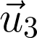
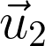
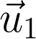
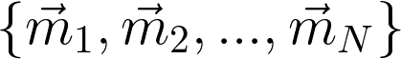
Memory Networks (Weston et al., ICLR15)
supervision
Addressing = max => Hard attention
requires explicit supervision of attention during training
Only feasible for simple tasks
Output
supervision
read
supervision
addressing
Controller module
Memory Module
read
addressing
Memory vectors
(unordered)
Internal state
vector
Input
Notes:
The model consists from two parts
…
Let take a closer look at memory module

Slide 9
End-to-end Memory Networks (Sukhbaatar et al., NIPS15)
supervision
Output
read
addressing
Controller module
Memory Module
read
addressing
Input
Notes:
The model consists from two parts
…
Let take a closer look at memory module

Slide 10
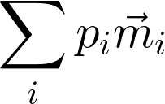
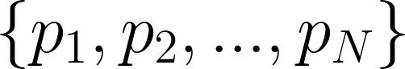
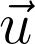
Memory Module
Weighted Sum
Attention weights
/ Soft address
To controller
(added to
controller state)
Softmax
Dot Product
Addressing signal
(controller
state vector)
Memory vectors
Notes:
Lets take closer look at memory module
…

Slide 11
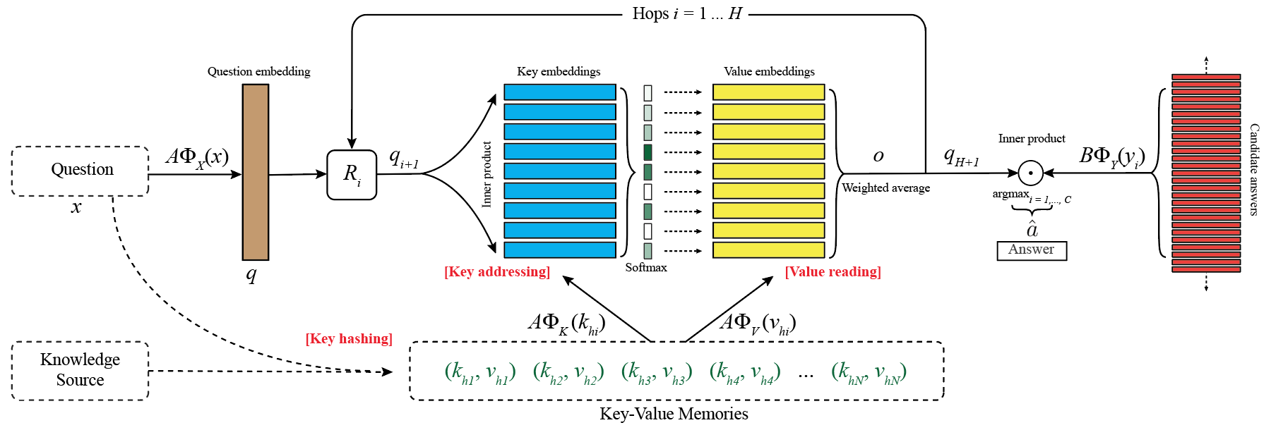
Memory Networks on bAbI
Where is the milk?
hallway
John
(m₁, m₂, m₃, m₄, …)
milk
(m₁, m₂, m₃, m₄, …)
John
Memories
John dropped the milk.
John took the milk there.
Sandra went to the bathroom.
John moved to the hallway.
Mary went back to the bedroom.
Memories
hallway
m1: John dropped the milk.
m2: John took the milk there.
m4: John moved to the hallway.
m5: Mary went back to the bedroom.
m3: Sandra went to the bathroom.
office
…

Slide 12
Dashboard
Weakly supervised
Supervised Supp. Facts
TASK | N-grams | LSTMs | MemN2N | Memory Networks | StructSVM+coref+srl
T1. Single supporting fact | 36 | 50 | PASS | PASS | PASS
T2. Two supporting facts | 2 | 20 | 87 | PASS | 74
T3. Three supporting facts | 7 | 20 | 60 | PASS | 17
T4. Two arguments relations | 50 | 61 | PASS | PASS | PASS
T5. Three arguments relations | 20 | 70 | 87 | PASS | 83
T6. Yes/no questions | 49 | 48 | 92 | PASS | PASS
T7. Counting | 52 | 49 | 83 | 85 | 69
T8. Sets | 40 | 45 | 90 | 91 | 70
T9. Simple negation | 62 | 64 | 87 | PASS | PASS
T10. Indefinite knowledge | 45 | 44 | 85 | PASS | PASS
T11. Basic coreference | 29 | 72 | PASS | PASS | PASS
T12. Conjunction | 9 | 74 | PASS | PASS | PASS
T13. Compound coreference | 26 | PASS | PASS | PASS | PASS
T14. Time reasoning | 19 | 27 | PASS | PASS | PASS
T15. Basic deduction | 20 | 21 | PASS | PASS | PASS
T16. Basic induction | 43 | 23 | PASS | PASS | 24
T17. Positional reasoning | 46 | 51 | 49 | 65 | 61
T18. Size reasoning | 52 | 52 | 89 | PASS | 62
T19. Path finding | 0 | 8 | 7 | 36 | 49
T20. Agent’s motivation | 76 | 91 | PASS | PASS | PASS
Training on 1k stories

Slide 13
Attention during memory lookups
Samples from toy QA tasks
 | Test Acc | Failed tasks
MemNN | 93.3% | 4
LSTM | 49% | 20
MemN2N 1 hop | 74.82% | 17
2 hops | 84.4% | 11
3 hops | 87.6.% | 11
20 bAbI Tasks

Slide 14
Related Memory Models (published before or ~same time as original paper)
RNNSearch (Bahdanau et al.) for Machine Translation
Can be seen as a Memory Network where memory goes back only one sentence (writes embedding for each word).
At prediction time, reads memory and performs a soft max to find best alignment (most useful words). 1 hop only.
Generating Sequences With RNNs (Graves, ‘13)
Also does alignment with previous sentence to generate handwriting (so RNN knows what letter it’s currently on).
Neural Turing Machines (Graves et al., 14) [on arxiv just 5 days after MemNNs!]
Has read and write operations over memory to perform tasks (e.g. copy, sort, associative recall).
128 memory slots in experiments; content addressing computes a score for each slot ➔ slow for large memory?
Earlier work by (Das ‘92), (Schmidhuber et al., 93), DISCERN (Miikkulainen, ‘90) and others...

Slide 15
Learning of Basic Algorithms using Reasoning, Attention, Memory (RAM) (e.g. addition, multiplication, sorting)
Methods include adding stacks and addressable memory to RNNs:
“Neural Net Architectures for Temporal Sequence Processing” M. Mozer.
“Neural Turing Machines” A. Graves, G. Wayne, I. Danihelka.
“Inferring Algorithmic Patterns with Stack Augmented Recurrent Nets” A. Joulin, T. Mikolov
“Learning to Transduce with Unbounded Memory” E. Grefenstette et al.
“Neural Programmer-Interpreters” S. Reed, N. de Freitas.
“Reinforcement Learning Turing Machine” W. Zaremba and I. Sutskever.
“Learning Simple Algorithms from Examples” W. Zaremba, T. Mikolov, A. Joulin, R. Fergus
“The Neural GPU and the Neural RAM machine” I. Sutskever.

Slide 16
How about on real data? In other conditions?
Toy AI tasks are important for developing innovative methods.
But they do not give all the answers.
How do these models work in real/different conditions?
Story understanding (Children’s Book, News articles)
Open Question Answering (Knowledge Bases, Wikipedia)
Dialog (Synthetic Dialog, Ubuntu)

Slide 17
Story Understanding

Slide 18
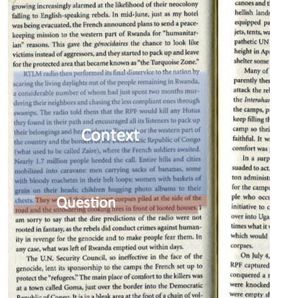
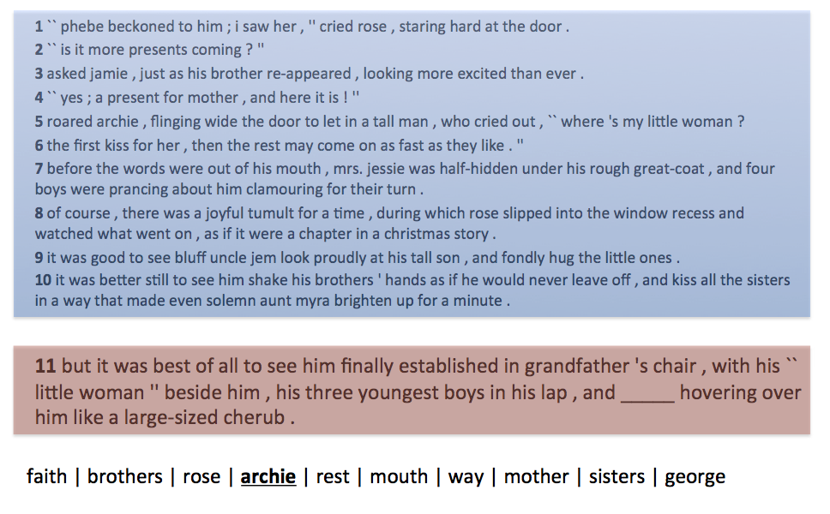
Children’s Books Test (CBT) (Hill et al., ICLR16)
Story understanding dataset based on 118 children books from project Gutenberg

Slide 19
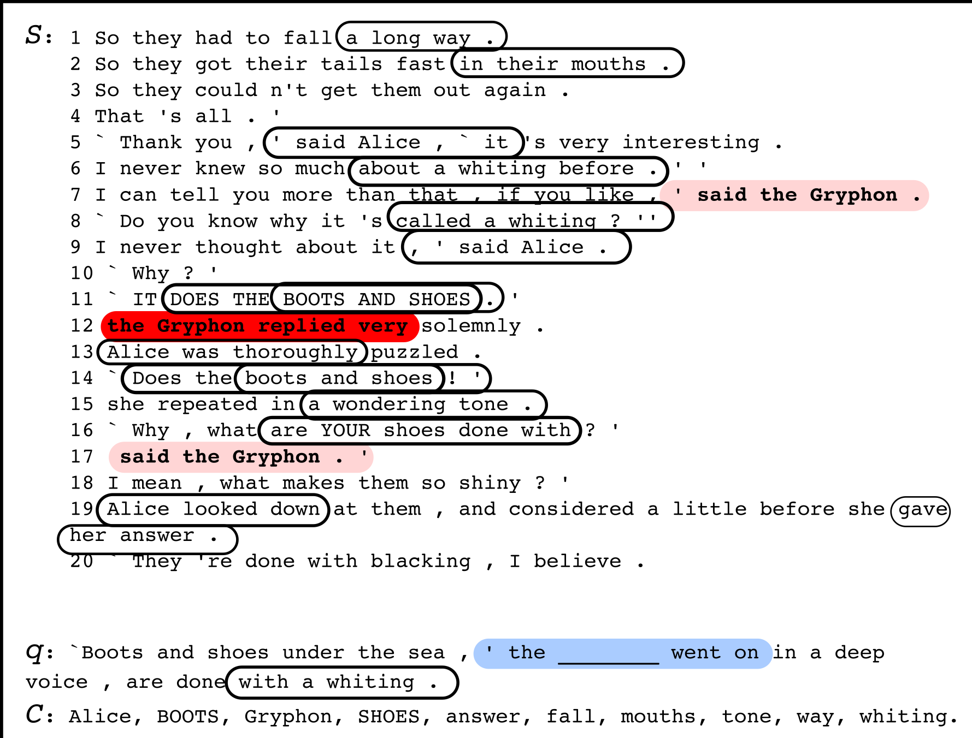
Memory Networks on CBT
Memories format?
Sentence: whole sentences
(as in the bAbI tasks)
Word: 1 word at a time
(language modeling style)
Words window: store windows made through the story
(convolution style)

Slide 20
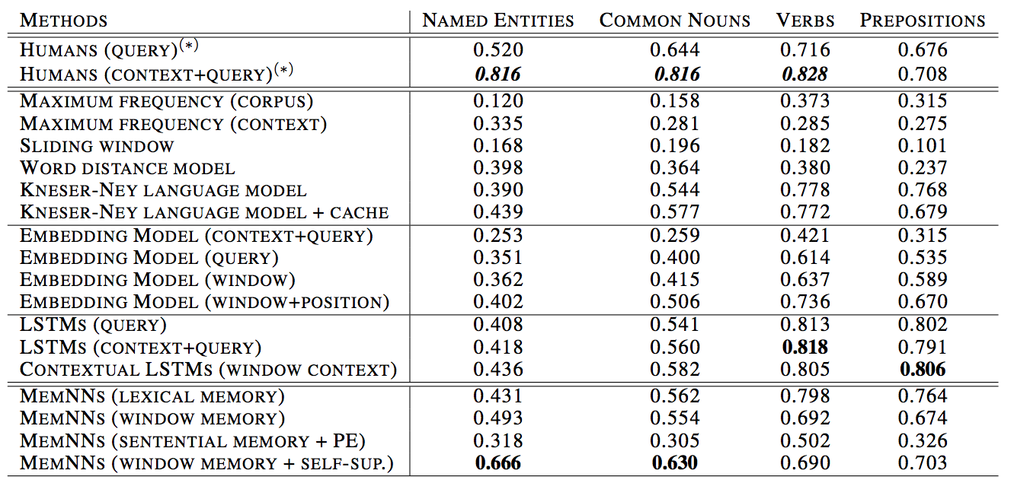
Different Word Types / Different Models

Slide 21
Question Answering on New’s Articles
We evaluate our models on the data from:
“Teaching Machines to Read and Comprehend”
Karl Moritz Hermann, Tomáš Kočiský, Edward Grefenstette, Lasse Espeholt, Will Kay, Mustafa Suleyman, Phil Blunsom

Slide 22
Latest Fresh Results
Our best results:
QACNN: 69.4 CBT-NE: 66.6 CBT-CN: 63.0
Text Understanding with the Attention Sum Reader Network. Kadlec et al. (4 Mar ‘16) QACNN: 75.4 CBT-NE: 71.0 CBT-CN: 68.9
Iterative Alternating Neural Attention for Machine Reading. Sordoni et al. (7 Jun ’16) QACNN: 76.1 CBT-NE: 72.0 CBT-CN: 71.0
Natural Language Comprehension with the EpiReader. Trischler et al. (7 Jun ’16) QACNN: 74.0 CBT-NE: 71.8 CBT-CN: 70.6
Gated-Attention Readers for Text Comprehension. Dhingra et al. (5 Jun ’16) QACNN: 77.4 CBT-NE: 71.9 CBT-CN: 69.0

Slide 23
Open Question Answering

Slide 24
Open-domain Question Answering
Answer questions on any topic
Knowledge Base (KB)
KBs can suffer from missing information and fixed schemas
[Blade Runner, directed_by, Ridley Scott] [Blade Runner, written_by, Philip K. Dick, Hampton Fancher] [Blade Runner, starred_actors, Harrison Ford, Sean Young, …]
[Blade Runner, release_year, 1982] [Blade Runner, has_tags, dystopian, noir, police, androids, …]
[…]
???????????????????
What year was the movie Blade Runner released?
Can you describe Blade Runner in a few words?
In Blade Runner, who built the Replicants?
1982
A dystopian and noir movie
???

Slide 25
Information Extraction
Wikipedia Entry: Blade Runner
Blade Runner is a 1982 American neo-noir dystopian science fiction film directed by Ridley Scott and starring Harrison Ford, Rutger Hauer, Sean Young, and Edward James Olmos. The screenplay, written by Hampton Fancher and David Peoples, is a modified film adaptation of the 1968 novel “Do Androids Dream of Electric Sheep?” by Philip K. Dick. The film depicts a dystopian Los Angeles in November 2019 in which genetically engineered replicants, which are visually indistinguishable from adult humans, are manufactured by the powerful Tyrell Corporation as well as by other “mega-corporations” around the world…
[Blade Runner, directed_by, Ridley Scott] [Blade Runner, written_by, Philip K. Dick, Hampton Fancher] [Blade Runner, starred_actors, Harrison Ford, Sean Young, …]
[Blade Runner, release_year, 1982] [Blade Runner, has_tags, dystopian, noir, police, androids, …]
Knowledge Base (KB)
[Replicants, manufactured_by, Tyrell Coporation ]
IE is not an easy problem!
What year was the movie Blade Runner released?
Can you describe Blade Runner in a few words?
In Blade Runner, who built the Replicants?
1982
A dystopian and noir movie
Tyrell Corporation
???

Slide 26
Question Answering Directly from Text
Wikipedia Entry: Blade Runner
Blade Runner is a 1982 American neo-noir dystopian science fiction film directed by Ridley Scott and starring Harrison Ford, Rutger Hauer, Sean Young, and Edward James Olmos. The screenplay, written by Hampton Fancher and David Peoples, is a modified film adaptation of the 1968 novel “Do Androids Dream of Electric Sheep?” by Philip K. Dick. The film depicts a dystopian Los Angeles in November 2019 in which genetically engineered replicants, which are visually indistinguishable from adult humans, are manufactured by the powerful Tyrell Corporation as well as by other “mega-corporations” around the world…
Much more information than in KB
But QA is harder
What year was the movie Blade Runner released?
Can you describe Blade Runner in a few words?
In Blade Runner, who built the Replicants?
1982
A dystopian and noir movie
Tyrell Corporation

Slide 27
MovieQA (Miller et al., arxiv16)
Hypothesis: Systems answering from text directly must be on par with systems using KBs for questions whose answers are in KBs.
MovieQA: a new analysis tool for QA
A set of 100k question -- answer pairs (based on SimpleQuestions)
3 knowledge sources:
A KB based on OMDb
Raw text extracted from Wikipedia
An imperfect KB made by an IE system ran on the Wikipedia articles
Answers to all questions are in the KB and in the Wikipedia text.

Slide 28
Memory Networks for QA from KB (Bordes et al., arxiv15)
What year was the movie Blade Runner released?
1982
Tron
(m₁, m₂, m₃, m₄, …)
1982
[…] […] […]
KB
Memories
police
[Blade Runner, directed_by, Ridley Scott] [Blade Runner, written_by, Philip K. Dick, Hampton Fancher] [Steven Spielberg, directed, Jurassic Park, …]
[Blade Runner, release_year, 1982] [Blade Runner, has_tags, dystopian, noir, police, androids, …]
[…]
[Blade Runner, release_year, 1982]
[Blade Runner, written_by, Philip K. Dick]
[Blade Runner, directed_by, Ridley Scott]
Tom Cruise
…

Slide 29
Memory Networks for QA from Text (Hill et al., ICLR16)
What year was the movie Blade Runner released?
1982
Tron
(m₁, m₂, m₃, m₄, …)
1982
[…] […] […]
Wikipedia Entry: Blade Runner
Blade Runner is a 1982 American neo-noir dystopian science fiction film directed by Ridley Scott and starring Harrison Ford, Rutger Hauer, Sean Young, and Edward James Olmos. The screenplay, written by Hampton Fancher and David Peoples, is a modified film adaptation of the 1968 novel “Do Androids Dream of Electric Sheep?” by Philip K. Dick. The film depicts a dystopian Los Angeles in November 2019 in which genetically engineered replicants, which are visually indistinguishable from adult humans, are manufactured by the powerful Tyrell Corporation as well as by other “mega-corporations” around the world…
Memories
police
is a 1982 American neo-noir
directed by Ridley Scott and starring
written by H. Fancher and David Peoples
Tom Cruise
…

Slide 30
Memory Networks on MovieQA
Memory Networks
Standard QA
System on KB
93.5%
24%
No Knowledge
(embeddings)
54.4%
Response accuracy (%)

Slide 31
Structuring Memories
Structure in the symbolic memories
Parts of the memories match questions where others encode response
Prior knowledge on the task
Which Wikipedia page do the windows come from?
Which knowledge source do memories have been extracted from?
[Blade Runner, directed_by, Ridley Scott]
directed by Ridley Scott and starring
[Blade Runner, release_year, 1982]
is a 1982 American neo-noir

Slide 32
Key-Value Memory Networks on KB
What year was the movie Blade Runner released?
1982
Tron
1982
[…] […] […]
KB
police
[Blade Runner, directed_by, Ridley Scott] [Blade Runner, written_by, Philip K. Dick, Hampton Fancher] [Steven Spielberg, directed, Jurassic Park, …]
[Blade Runner, release_year, 1982] [Blade Runner, has_tags, dystopian, noir, police, androids, …]
[…]
[Blade Runner, release_year] / 1982
[Blade Runner, written_by] / Philip K. Dick
[Blade Runner, directed_by] / Ridley Scott
Tom Cruise
…

Slide 33
Key-Value Memory Networks on Text
What year was the movie Blade Runner released?
1982
Tron
[…] […] […]
1982
Wikipedia Entry: Blade Runner
Blade Runner is a 1982 American neo-noir dystopian science fiction film directed by Ridley Scott and starring Harrison Ford, Rutger Hauer, Sean Young, and Edward James Olmos. The screenplay, written by Hampton Fancher and David Peoples, is a modified film adaptation of the 1968 novel “Do Androids Dream of Electric Sheep?” by Philip K. Dick. The film depicts a dystopian Los Angeles in November 2019 in which genetically engineered replicants, which are visually indistinguishable from adult humans, are manufactured by the powerful Tyrell Corporation as well as by other “mega-corporations” around the world…
is a 1982 American neo-noir / 1982
police
directed by R. Scott and starring / R. Scott
is a 1982 American neo-noir / Blade Runner
written by H. Fancher and D. P. / H. Fancher
directed by R. Scott and starring / Blade Runner
written by H. Fancher and D. P. / Blade Runner
Tom Cruise
…

Slide 34
Results on MovieQA
Memory Networks
Key-Value Memory Networks
Standard QA
System on KB
93.5%
17%
No Knowledge
(embeddings)
54.4%
Response accuracy (%)

Slide 35
Synthetic Documents
DIFFICULTY
KB: [Flags of Our Fathers, directed_by, Clint Eastwood]
One Template: Clint Eastwood directed Flags of Our Fathers
All Templates: Flags of Our Fathers was directed by Clint Eastwood.
One Template + coref.: Flags of Our Fathers came out in 2006. Clint Eastwood directed it.
One Template + conjunctions: Flags of Our Fathers is in English and Clint Eastwood directed Flags of Our Fathers.
All Templates + coref. + conj.: Flags of Our Fathers is a famous film. Ryan Phillippe, Jesse Bradford, Adam Beach, and John Benjamin Hickey are the actors in it and Clint Eastwood is the person who directed it.
Wikipedia: The film adaptation Flags of Our Fathers, which opened in the U.S. on October 20, 2006, was directed by Clint Eastwood and produced by Steven Spielberg, with a screenplay written by William Broyles, Jr. and Paul Haggis.

Slide 36
Synthetic Documents Analysis
Key-Value Memory Networks
Response accuracy (%)

Slide 37
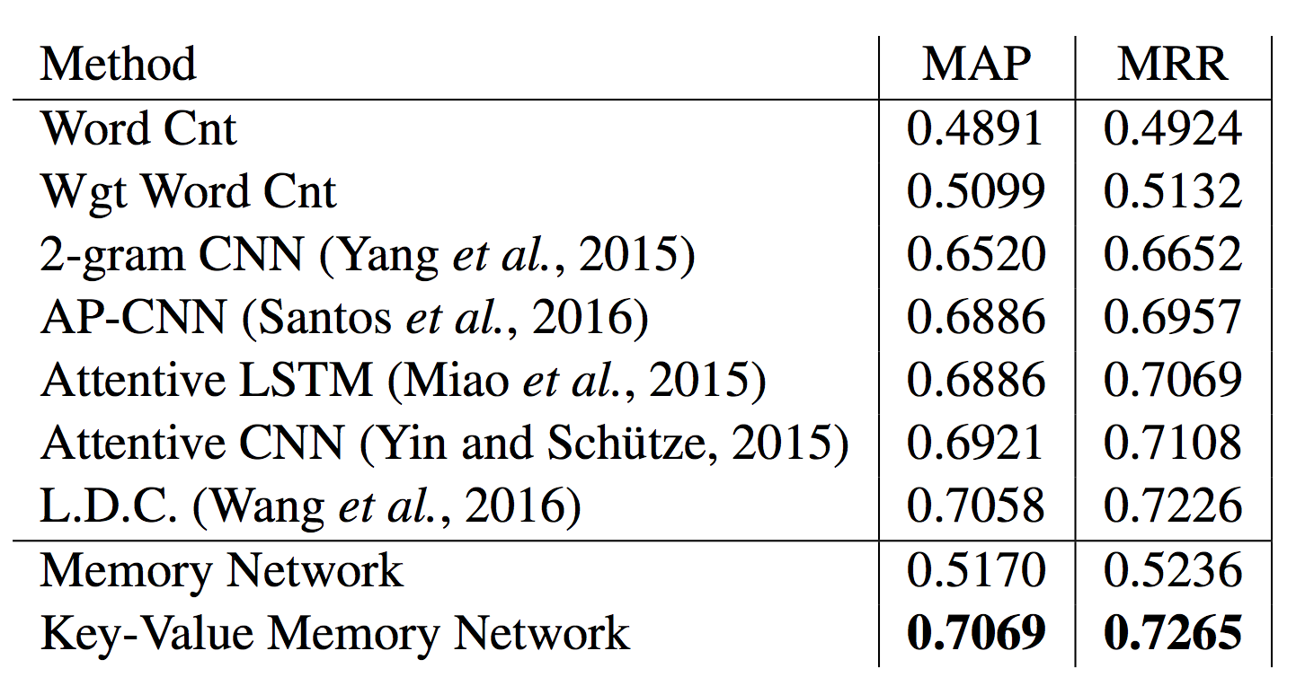
WikiQA (Yang et al., EMNLP15)
QA Benchmark in the answer selection setting
Key-Value Memories -> (window, sentence)
Q: How are glacier caves formed ?
A: A glacier cave is a cave formed within the ice of a glacier
Training size is very small (~1k examples):
Word embeddings pre-trained on Wikipedia and fixed
Dropout regularization

Slide 38
Dialog

Slide 39
How about on dialog data?
Everything we showed so far was Q&A potentially with long-term context.
We have also built a Movie Dialog Dataset (Dodge et al., ICLR16)
Closed, but large, domain about movies (75k entities, 3.5M ex).
Ask facts about movies?
Ask for opinions (recommendations) about movies?
Dialog combining facts and opinions?
General chit-chat about movies (statements not questions)?
And… combination of all above in one end-to-end model.

Slide 40
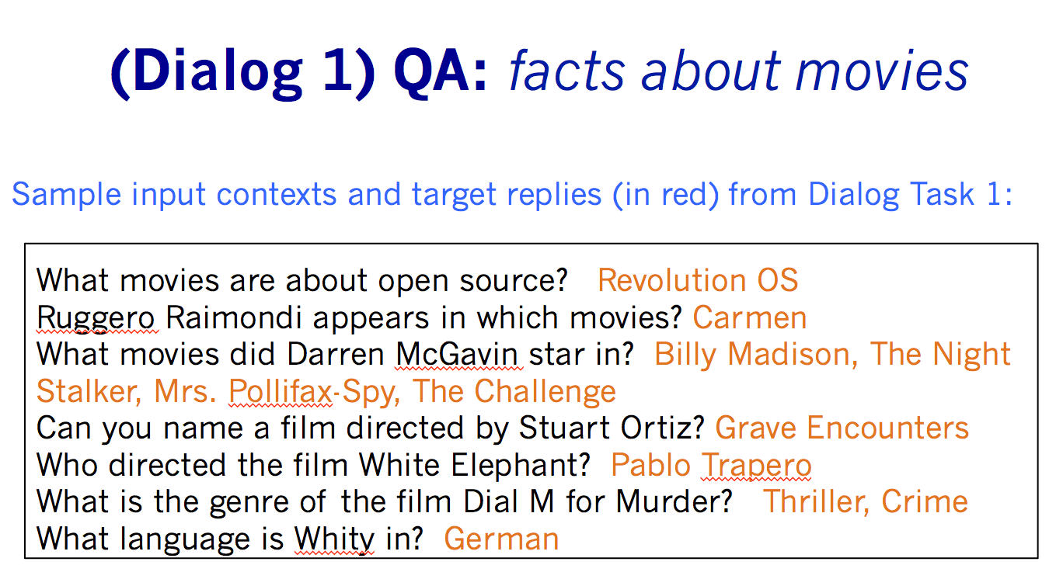
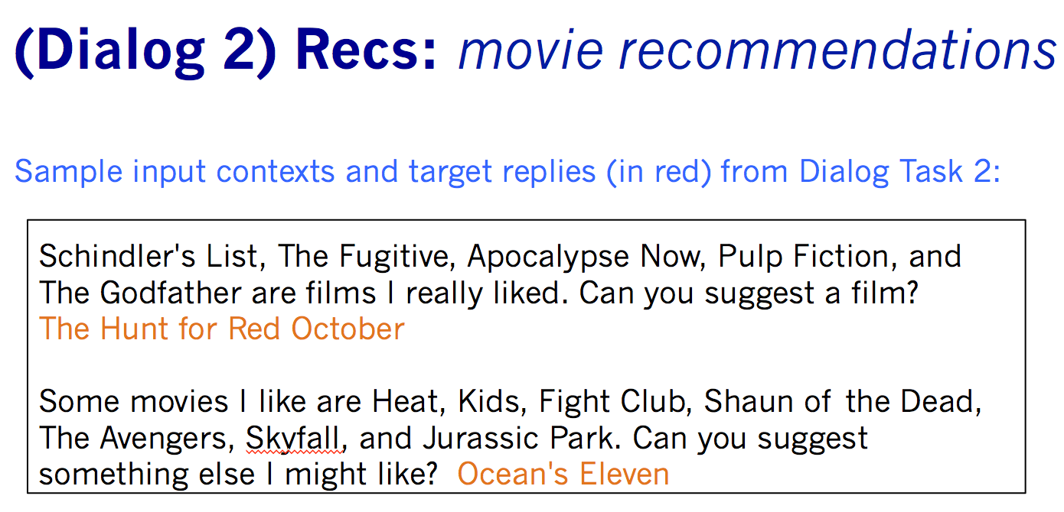
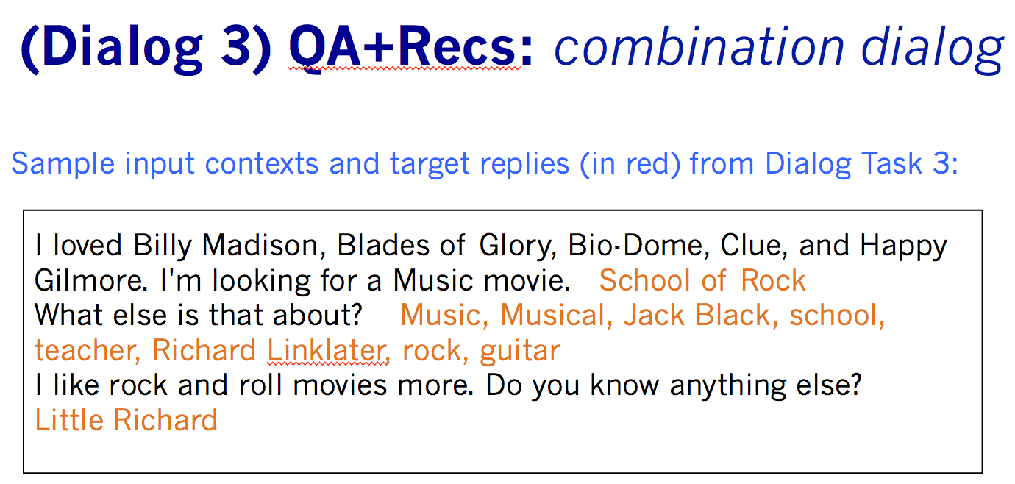
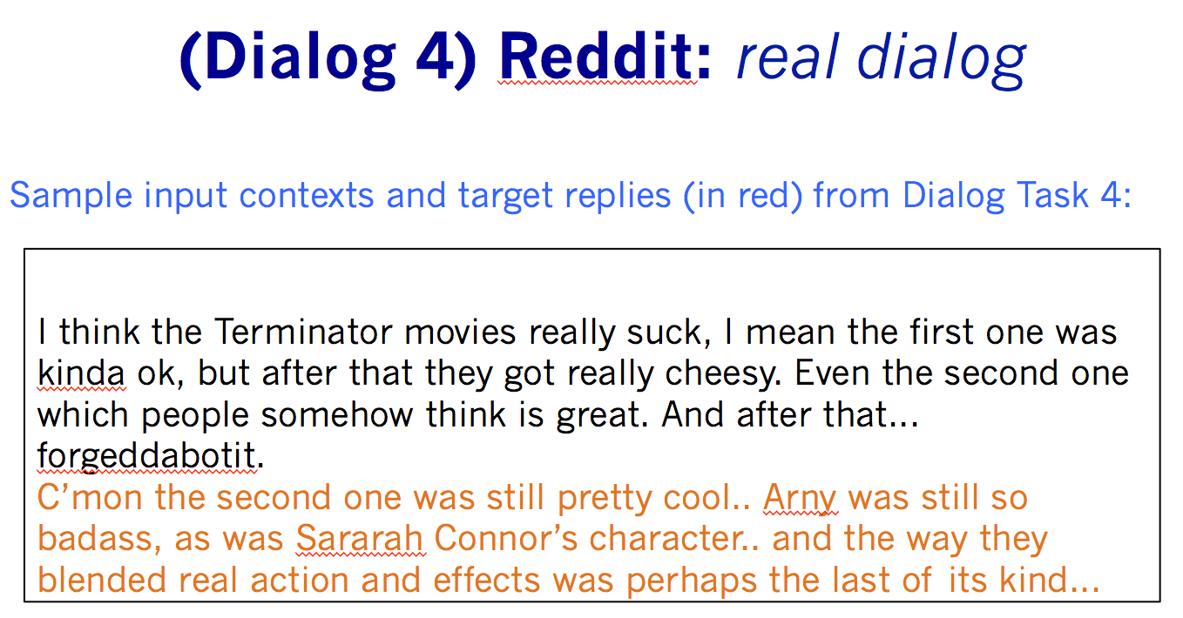
Combines QA with Dialog Tasks (Dodge et al., ICLR16)

Slide 41
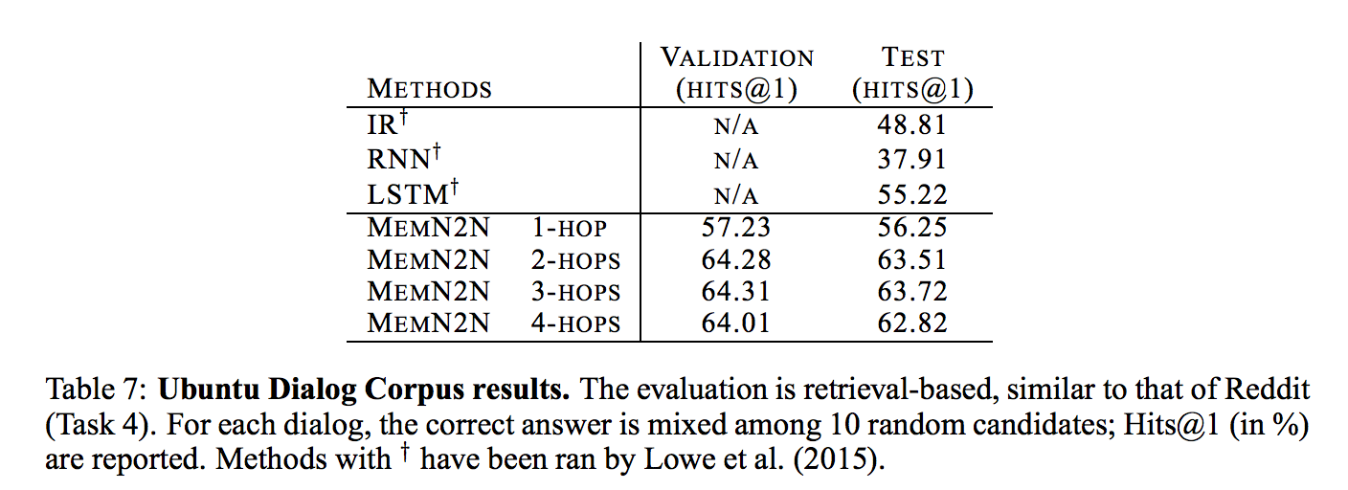
Ubuntu Data (Lowe et al. McGill, ‘15)
Dialog dataset: Ubuntu IRC channel logs, users ask questions about issues they are having with Ubuntu and get answers by other users.
Best current results: “Sentence Pair Scoring: Towards Unified Framework for Text Comprehension” (Baudis et al., 2016) => RNN-CNN combo: 67.2

Slide 42
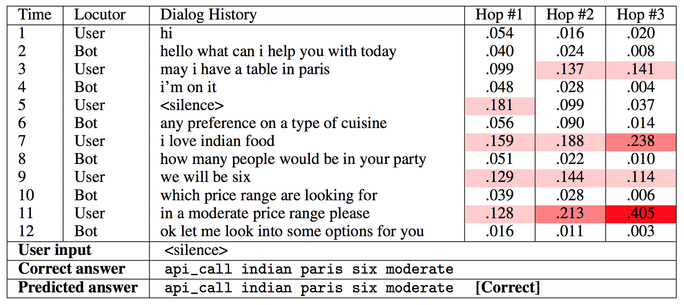
Goal-oriented Dialog (Bordes et al., arxiv16)
bAbI tasks for goal-oriented dialog
6 tasks around restaurant booking
Involve manipulate language and KB symbols
MemNNs for Goal-oriented Dialog

Slide 43
Next Steps

Slide 44
Variants of the class…
Some options and extensions:
Representation of inputs and memories could use all kinds of encodings: bag of words, RNN style reading at word or character level, etc.
Different possibilities for output module: e.g. multi-class classifier or uses an RNN to output sentences.
If the memory is huge (e.g. Wikipedia) we need to organize the memories. Solution: hash the memories to store in buckets (topics). Then, memory addressing and reading doesn’t operate on all memories.
If the memory is full, there could be a way of removing one it thinks is most useless; i.e. it ``forgets’’ somehow. That would require a scoring function of the utility of each memory..

Slide 45
Conclusion
(Key-Value) Memory Networks: promising model for jointly using symbolic and continuous systems
Can be trained end-to-end through backpropagation + SGD
Provide a great flexibility on how to design memories
bAbI, CBT, MovieQA, etc.: new tools for developing learning algorithms
Training and evaluation sets of reasonable sizes
Designed to ease interpretation

Slide 46
Open Research
Papers:
Key-Value Memory Networks: http://arxiv.org/abs/1606.03126
Memory Networks: http://arxiv.org/abs/1410.3916
End-to-end Memory Networks: http://arxiv.org/abs/1503.08895
bAbI tasks: http://arxiv.org/abs/1502.05698
Children’s Books Test: http://arxiv.org/abs/1511.023701
Large-scale QA with Memory Networks: http://arxiv.org/abs/1506.02075
Evaluating pre-requisite qualities of dialog systems: http://arxiv.org/abs/1511.06931
Dialog bAbI tasks: http://arxiv.org/abs/1605.07683
Dialog-based language learning: http://arxiv.org/abs/1604.06045
Data: fb.ai/babi (7 datasets including bAbI tasks, CBT and MovieQA)
Code:
Memory Networks: https://github.com/facebook/MemNN
bAbI tasks generator: https://github.com/facebook/bAbI-tasks
MemNN
Q&A
Dialog

Slide 47
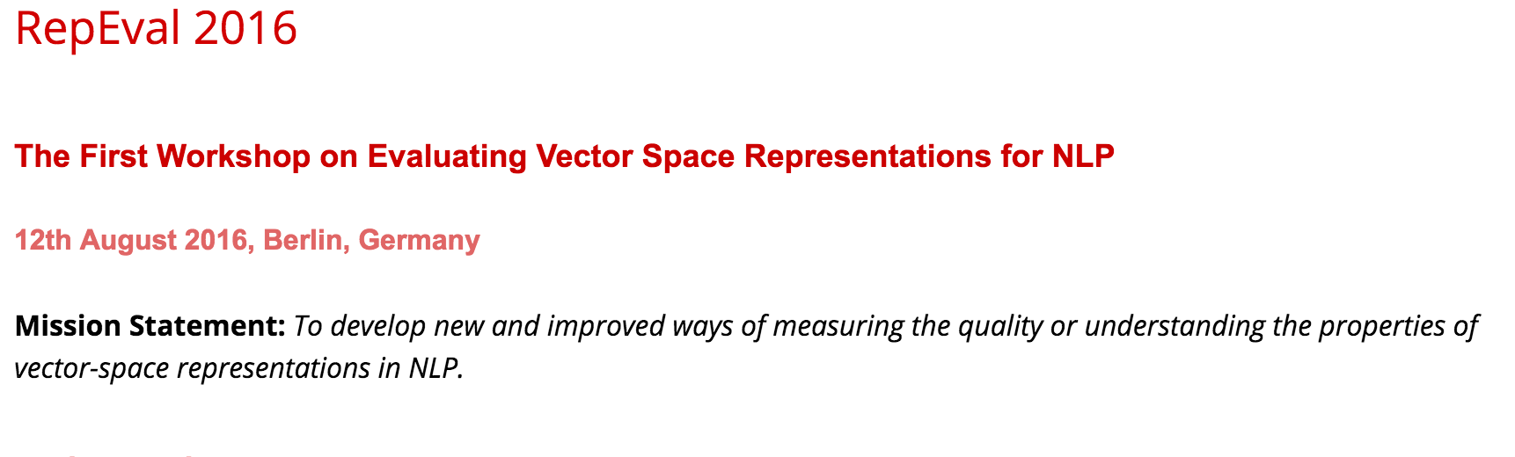
RepEval @ ACL 2016
https://sites.google.com/site/repevalacl16/

